Slide 1
athletes’ minds matter
supporting athletes’ mental and physical health

Slide 2
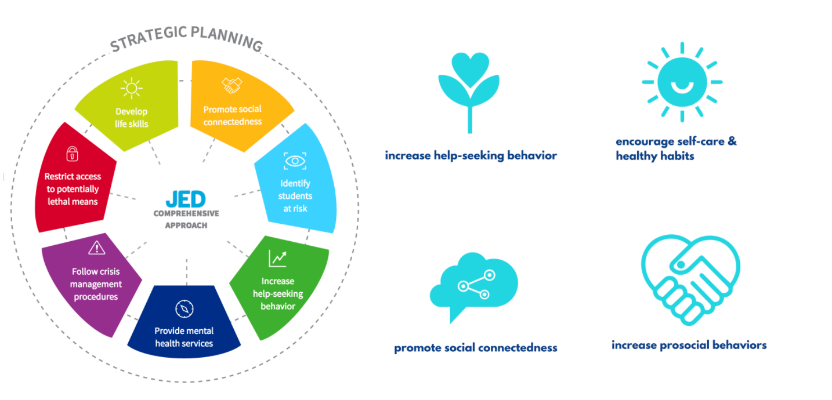
Our Minds Matter
Notes:
Our Minds Matter curriculum development was informed by the Jed’s Foundation comprehensive approach to suicide prevention. Additionally, OMM continues to develop further programing to be evidence-based AND is conducting research to to measure the effectiveness of the program with psychology experts in youth-led programming.
The goal of OMM is to
empower student leaders
to make a difference in school communities by helping peers to build the following protective factors for mental wellness:
these protective factors include self-care, social connectedness, prosocial skills and help-seeking behavior.
which have been proven to improve/maintain overall well-being AND reduce the likelihood a teen turns to sucide.

Slide 3
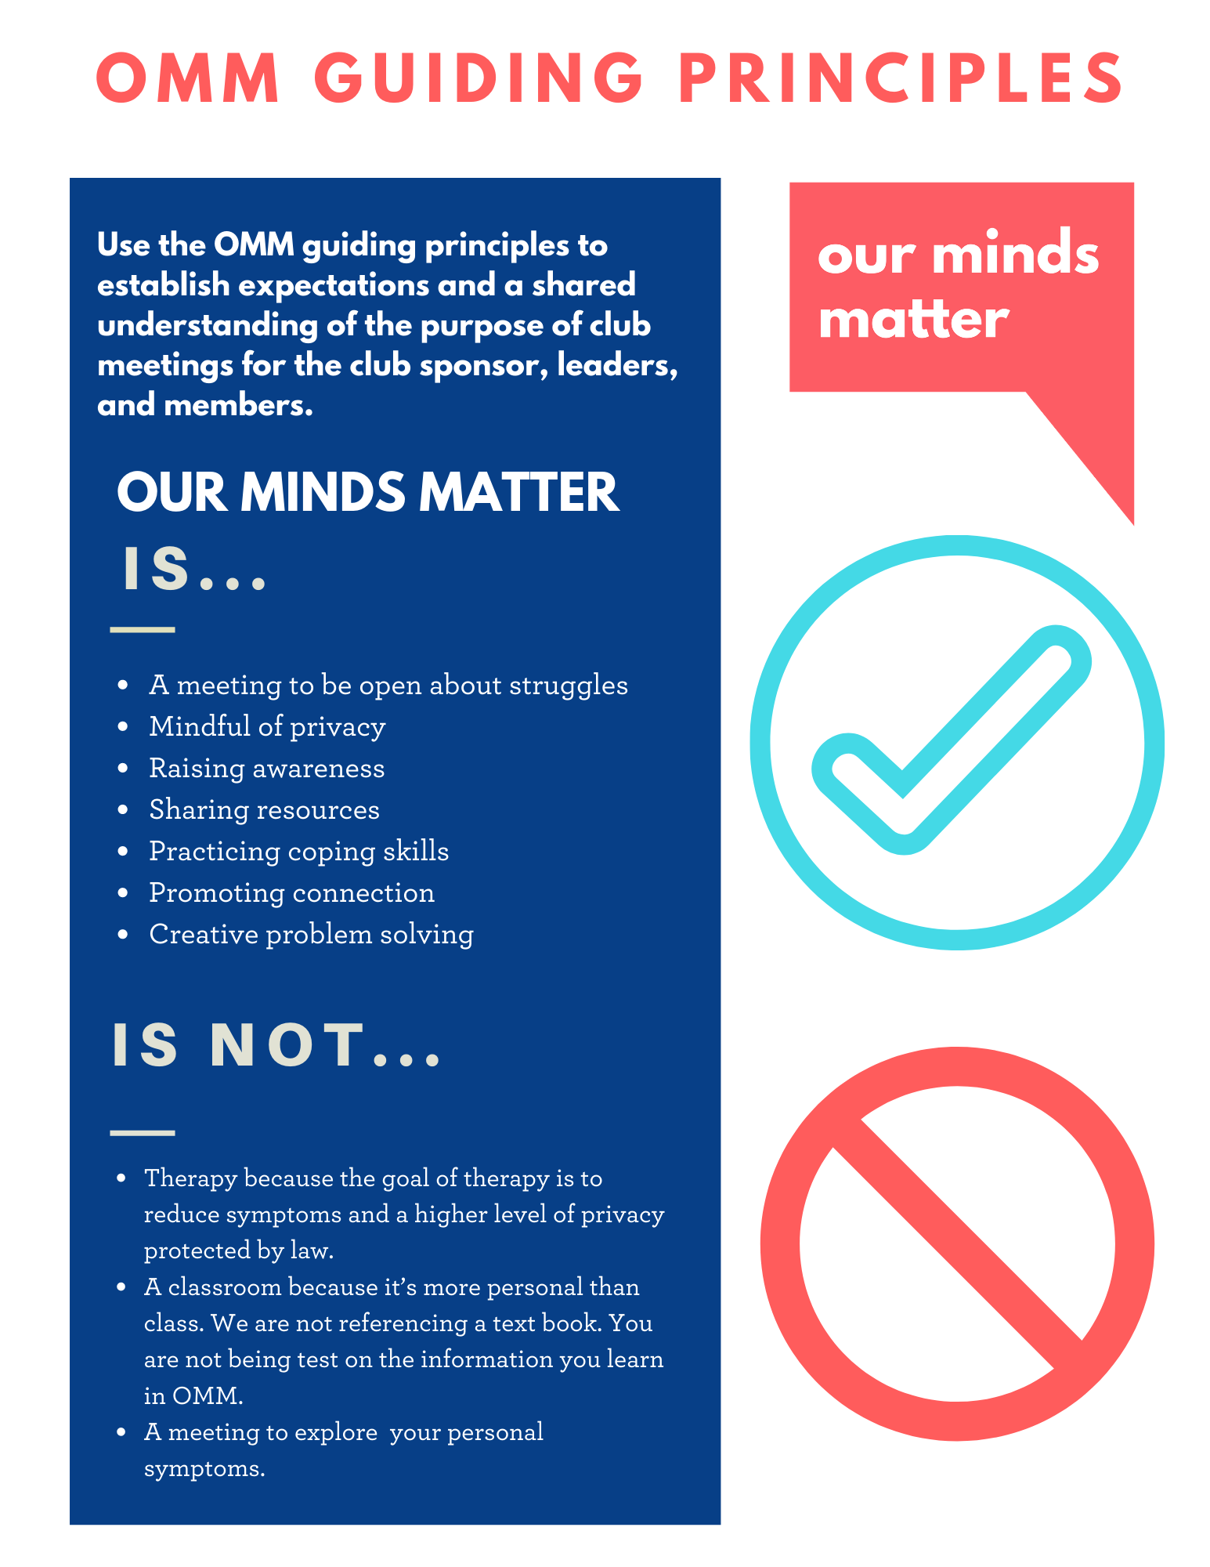
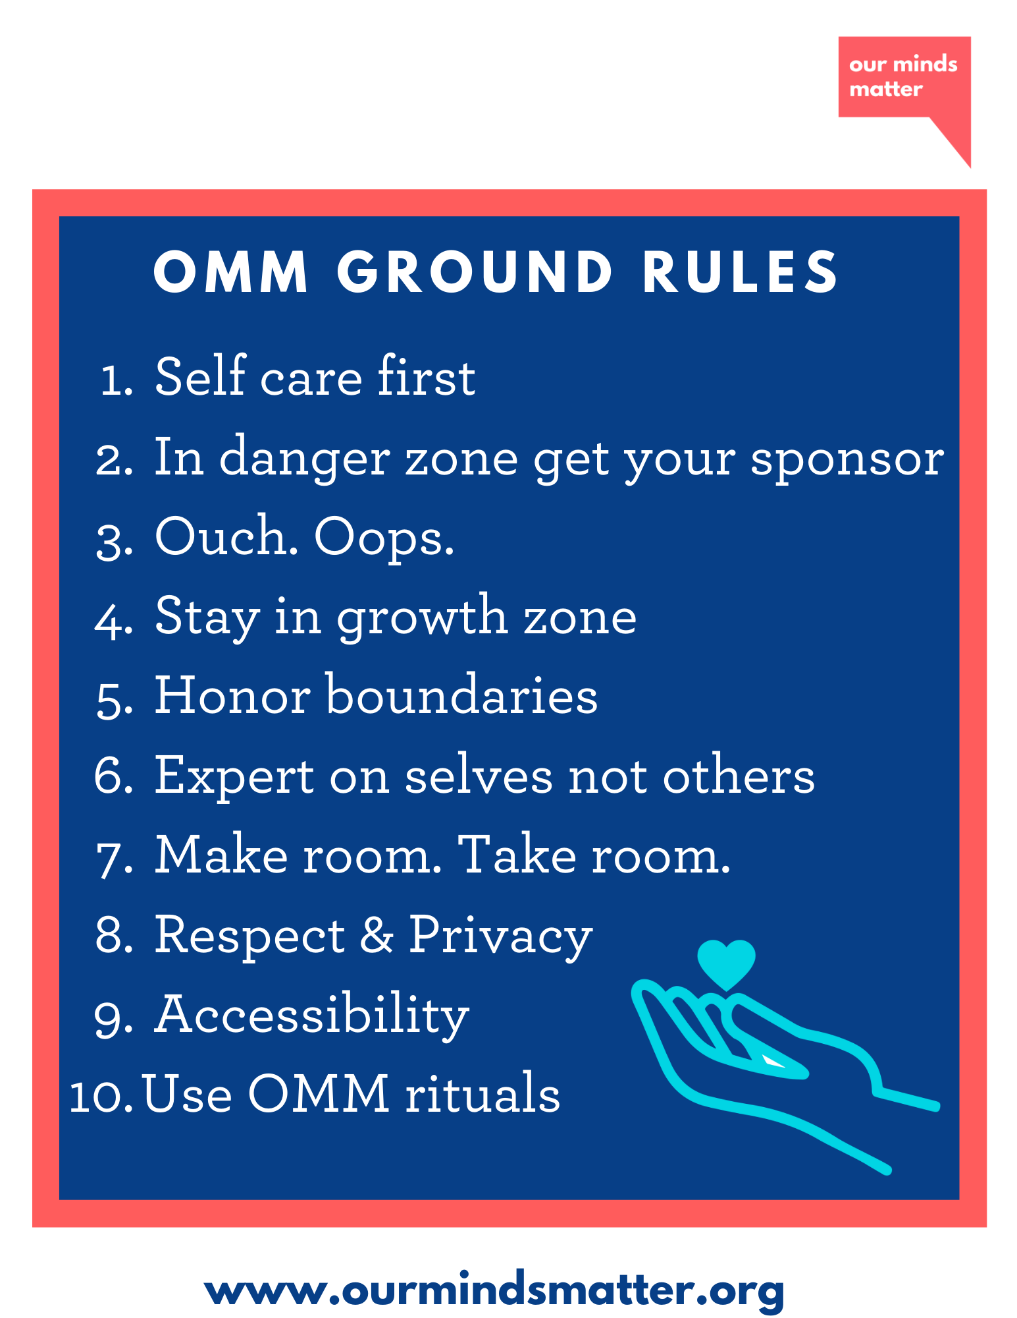
Notes:
explanation of OMM guiding principles and zones

Slide 4
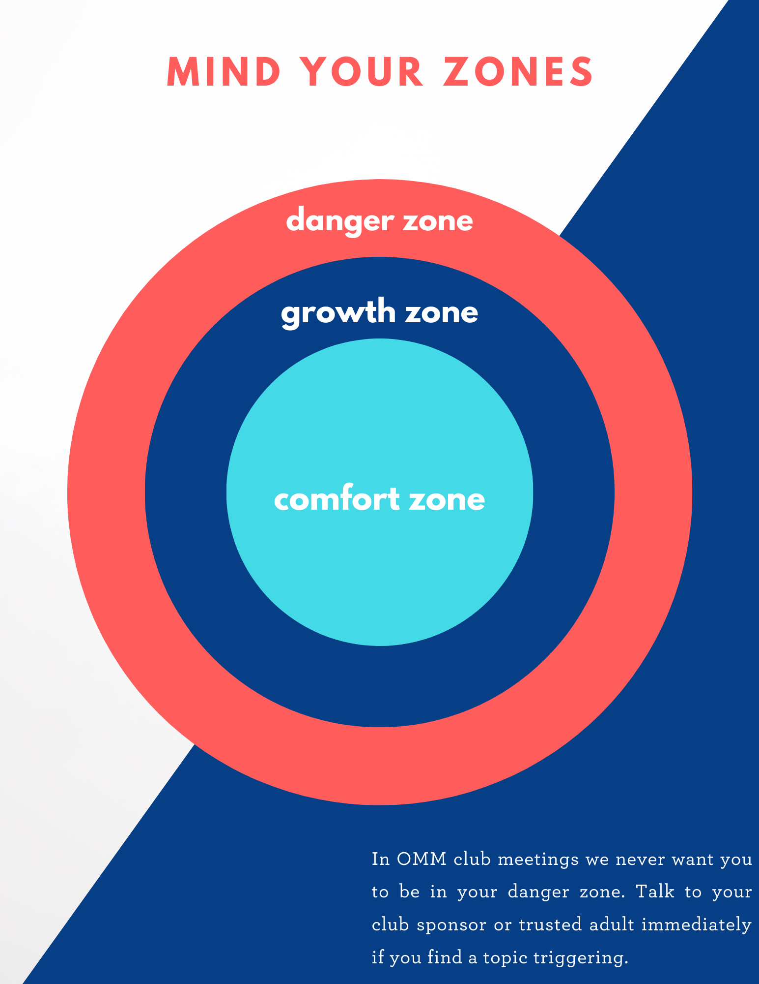
Notes:
Briefly explain zones and importance of staying out of “danger” zone

Slide 5
Smoke - something that has been clouding your mind recently or
something that is not going so well
Spark - something that you recently have become interested in
Fire - something that has brought you joy for a long time
smoke, spark, fire
Notes:
Introductions with pronouns first
Why use pronouns?
You can’t always know what someone’s pronouns are by looking at them. Asking and correctly using someone’s pronouns is one of the most basic ways to show your respect for their gender identity.
When someone is referred to with the wrong pronoun, it can make them feel disrespected, invalidated, dismissed, alienated, or dysphoric ( often all of the above.)
It is a privilege to not have to worry about which pronoun someone is going to use for you based on how they perceive your gender. If you have this privilege, yet fail to respect someone else’s gender identity, it is not only disrespectful and hurtful, but also oppressive

Slide 6
why athletes’ minds matter?
*A 2015 study demonstrates that student athletes report higher levels of negative emotional states than non-student athlete adolescents (The Atlantic, 2019).
*With 1 in 5 teenagers living with mental health concerns, studies show that injuries, emotional stress, and physical strain put high school athletes at higher risk for anxiety, depression, and suicidal ideation than their non-athlete peers (Ohio University, 2020).
*Among professional athletes, data shows that up to 35% of elite athletes experience a mental health crisis which may manifest as stress, eating disorders, burnout, or depression and anxiety (Athletes for Hope, 2021).
Notes:
Athletes’ Minds Matter was developed in 2020 by Our Minds Matter (OMM) summer interns. This program includes OMM activities and campaigns adapted for athletes by student athletes themselves. It lays out activities, team initiatives, and general mental health resources and provides athlete specific resources, specifically for coaches and leadership teams.

Slide 7
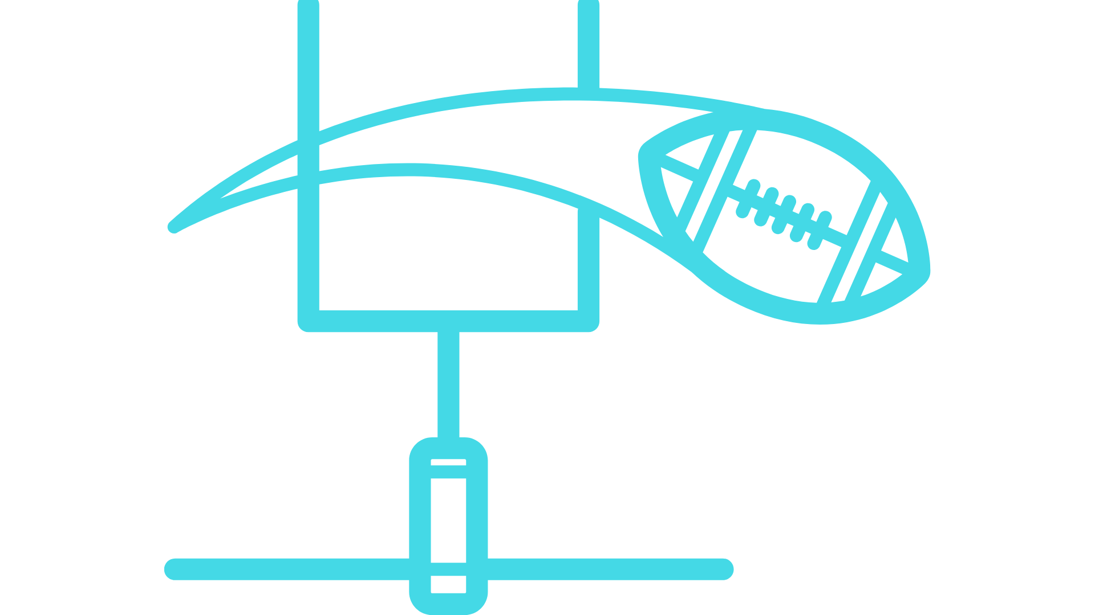
campaign goals
Educate coaches and athletes about the connection between mental and physical health
Reduce the stigma around mental health amongst athletes
Provide mental health resources and activities to coaches and captains
Foster inclusivity on athletic teams
Notes:
to educate coaches and athletes about the connection between physical and mental health
to reduce the stigma that exists, specifically amongst athletes, around mental health conversation
to provide resources and activities to coaches and captains
Foster inclusivity on athletic teams

Slide 8
coach’s role
Notes:
to set up regular check-ins with their athletes and communicate with captains about the team’s well-being
to facilitate team activities from the athletes’ minds matter guidebook at the start or end of practice
to familiarize self and athletes with national, local, and school specific mental health resources
to initiate and to encourage mental health conversations and healthy habits
to prioritize athletes’ mental health and understand the impact it has on their physical health

Slide 9
captain’s role
Notes:
to regularly check-in with teammates about their well-being
to set an example for younger athletes by organizing and leading team initiatives and activities
to make themselves available to all athletes via group chat, email chain, or other means of communication
to split the team into smaller groups for more private conversations (if part of a large team with multiple captains)
to communicate the athletes’ concerns and mental health needs to coaches and school faculty

Slide 10
athletic department’s role
Notes:
to check in with coaches and athletes at least twice per season to inquire about well-being and mental wellness
to be a resource to coaches and athletes as they foster conversations about mental health
to encourage all athletic teams under your department to utilize the AMM portal resources and activities

Slide 11
activity
Coping Strategy Keychains
Pass out an index card to each athlete. Take a minute or two to brainstorm out loud some positive coping skills.
Then, invite athletes to write down three positive coping skills that resonate with them on their index card. They can also feel free to decorate their cards as they would like.
Once they have finished, they can attach them to their equipment bags with ribbon so they will always have coping skills to turn to during practice or a competition.
Notes:
Explain that this is an example of an activity that can be found in the AMM portal. Briefly describe the activity and share that AMM activities are designed to take ABOUT TEN MINUTES, so they can be completed almost like a mental warm-up or cool-down.

Slide 12
know the
warning signs
Suicide warning sides require immediate attention.
Know what to look out for in student athletes.
Notes:
Read off some or all of the warning signs: Talking about wanting to die or kill oneself, Talking or writing about suicide or death, Talking about feeling hopeless or having no reason to live, Talking about being a burden to others and how the world would be better off without him/her, Talking about being trapped or in unbearable pain, Complete withdrawal, Showing rage or talking about seeking revenge, Displaying extreme mood swings and acting recklessly, Looking for ways to kill oneself, such as searching online or obtaining access to firearms, pills, or other means to kill oneself, Giving away prized possessions and other personal things; tying up loose ends.
Consider how these might appear in student athletes’ and what additional warning signs could look like. If students exhibit behaviors such as sitting out of practice, isolating oneself from their teammates, avoiding team meals, or just generally acting out of character, it is important to check in with them immediately and connect them to resources.

Slide 13
general resources
National Suicide Prevention Hotline: call 1-800-273-TALK(8255)
Copline: call Call 1-877-YOUTHLINE for teen-to-teen counseling
Call 1-800-Suicida for Spanish speakers
Teen Line: teenonline.org
The Trevor Project – LGBTQ Crisis Hotline
Call 1-866-488-738
[OMM specific crisis chatline]
Notes:
Encourage audience to remember these resources and post them around the school/athletic facilities. Also direct them to OMM website for more resources. You can email them these slides after the meeting so they have the warning signs and resources on hand.

Slide 14
our school’s mental
health resources
***Please fill this slide with your school specific resources. This would include contact information for members of the counseling department, school psychologists, and other teachers or faculty members who are willing to support this initiative***

Slide 15
ready to get started?
visit the athletes’ minds matter portal for all the resources and activities you need to spark the conversation about mental health
@our.minds.matter
Notes:
Link in portal and provide website

